Slide 1
ENG4118/5326 - Robotics 4/M Sensors, Actuators and Image capture, processing and analysis
Lectures 10
Kevin Worrall

Slide 2

Lecture Overview
Gears
Rack and Pinion
Ratchet and Pawl
Hydraulic System

Slide 3
Reduction Gears
Electric motors rotate at high speeds (up to thousands of rpm) and must be used with reduction gears to increase their torque and reduce their speed.
This increases the resolution of the system allowing small angle rotations of the system to be achieved but also has several drawbacks:
Increased cost and number of parts
Decreased reliability due to more parts
Increased weight and moments of inertia
Increased risk of backlash: the striking back of connected wheels in a mechanism when pressure is applied
3
Notes:
24/02/2025
3

Slide 4
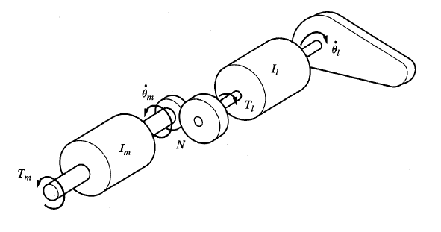
Reduction Gears
Suppose a load, with inertia I_{l} , is connected via a set of reduction gears, with reduction ratio N, to a motor, with inertia I_{m} (including the inertia of the reduction gears).
4
Notes:
24/02/2025
4

Slide 5
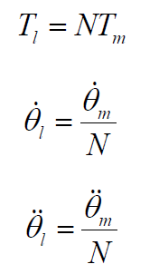
Reduction Gears
The torque and speed ratio between the motor and load are:
5
Notes:
24/02/2025
5

Slide 6
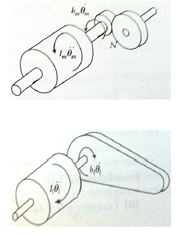
Reduction Gears
Writing the force-balance equations for the system and substituting in the torque and speed ratio defined previously we obtain:
Torque acting on motor shaft:
Torque acting on load:
6
Notes:
24/02/2025
6

Slide 7
Reduction Gears
Where b_{m} and b_{l} are viscous coefficients of friction for the motor and the load.
The motor torque can be re-written:
From this it can be seen that the effective inertia of the load as felt by the motor is inversely proportional to the square of the reduction gear ratio:
7
Notes:
24/02/2025
7

Slide 8
Reduction Gears
The motor only feels a fraction of the actual inertia of the load which in the case of a robot constitutes both the manipulator and the load it carries.
Reduction ratios of 20-100 are common in manipulator robots so that the actual inertia applied to the motor from the load may 1/400 th to 1/10,000 th of the actual inertia.
This allows robots to both accelerate and decelerate quickly and with high gear ratios the inertial effects of the load can be ignored by the robot’s control system.
In both hydraulic and electric direct drive systems (where non reduction gearing is required) the actuators are exposed to full inertial loads.
However, the opposite is also true that the effect of the inertia of the motor on the load is also 400-10,000 larger and to reduce this effect designers use long slender rotors or pancake motors.
8
Notes:
24/02/2025
8

Slide 9
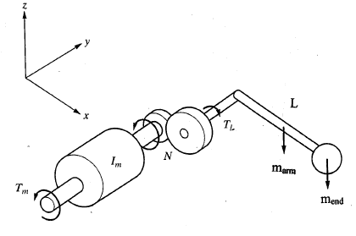
Reduction Gear Example
A motor with inertia 0.015Kgm 2 and maximum torque of 8Nm is connected to a uniformly distributed arm of length 0.5m and mass 3kg with a concentrated mass of 2kg on its end. Ignoring the inertia of a pair of reduction gears and the viscous friction in the system, calculate the total moment of inertia felt by the motor and the maximum angular acceleration it can develop if the gear ratio is: a) 3 b) 30
9
Notes:
24/02/2025
9

Slide 10
Reduction Gear Example Solution
The total moment of inertia of the arm and the concentrated mass at the centre of rotation is:
10
Notes:
24/02/2025
10

Slide 11
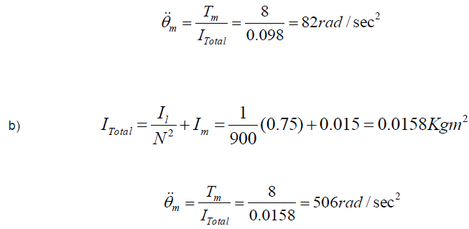
Reduction Gear Example Solution
11
Notes:
24/02/2025
11

Slide 12
Rotational to Translational Motion
Rack and pinions are another form of gear and essentially two intermeshed gears with one being a circle of theoretically infinite radius. They are used to transform rotary motion to linear motion.
Another method of achieving this is to use a screw and nut system where the nut is rotated using a motor and moves along the stationary screw attached to the part to be driven. This is termed a Lead Screw.
Issues with this configuration are due to high friction forces which can be overcome by using ball bearings in the thread of the nut and this is called a Ball Screw.
12
Notes:
24/02/2025
12

Slide 13
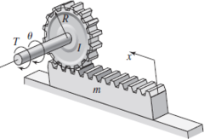

Rack and Pinion
Consider the rack and pinion system, the rotational motion of the pinion is transformed into the translational motion of the rack.
The net torque acting on the pinion is the difference between the input torque and the torque applied to the rack:
where I is the moment of inertia of the pinion and ω is its angular velocity.
13
Notes:
24/02/2025
13

Slide 14


Rack and Pinion
The rotation of the pinion results in a linear velocity of the rack, v.
If the pinion has radius r then v = rω and then:
For the rack there is a force T_{out} / r from the pinion and if a frictional force cv is present the net force on the rack is:
14
Notes:
24/02/2025
14

Slide 15
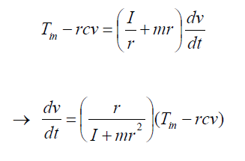
Rack and Pinion
Eliminating T_{out} gives:
15
Notes:
24/02/2025
15

Slide 16
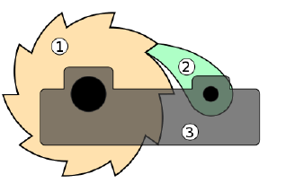
Ratchet and Pawl
Ratchets are used to lock mechanisms when they are holding a load.
The wheel (1) is termed the ratchet and has saw teeth which are used to engage the arm (2) called the pawl.
The shape of the teeth are such that motion can only occur in one-direction.
Clockwise rotation of the ratchet can only occur when the pawl is lifted and these tend to be spring-loaded to ensure automatic engagement with the ratchet teeth.
https://www.youtube.com/watch?v=lw04cZg59F4
16
Notes:
24/02/2025
16

Slide 17
Actuators
If the links and joints connecting the parts of a robot can be considered a skeleton, then the actuators are the muscles.
Actuators are used to move and change the links which change the configuration of the robot.
These must have enough power to accelerate and decelerate the links and carry the loads in addition to being light, economical, accurate, responsive, reliable and easily maintained.

Slide 18
Actuators
There are many types of actuator available with some of the most common:
Hydraulic actuators (use liquids, usually oil)
Pneumatic actuators (use compressed air)
AC, DC, Stepper motors

Slide 19
Hydraulic System

Slide 20
Hydraulic System
Common in many large robots of the past decades
Pressurised oil is provided by a pump driven by an electric motor
Due to relatively costly systems (pump, drive motor, valves...) they are no longer as widely used
Hydraulic systems use an accumulator which stores the constant energy of the pump and can deliver larger loads when necessary
One important difference with electric systems is that a hydraulic pumps are sized for average load whereas electric actuators must be sized for maximum load
Additionally, electric motors must be located near to the joint to be controlled whereas only the actuators, accumulators and control valves need be near the joint in hydraulic systems
The power unit may be located elsewhere reducing mass and motor inertia on the load

Slide 21
Hydraulic System - Main components
Hydraulic linear or rotary actuator: provides the force or torque needed to move the joints and is controlled by servo-valves or manual valves
Hydraulic pump: provides high pressure fluid to the system
Electric motor: operates the hydraulic pump
Cooling system: rids the system of excessive heat
Reservoir: keeps the fluid supply available to the system by storing excess fluid
Accumulators: used to store extra energy for maximum loads (a pressure storage reservoir where the fluid is held under pressure by an external source)

Slide 22
Hydraulic System - Main components
Servo-valves: control the amount and rate of fluid flowing into the actuators
Check valves: used for safety and controlling maximum pressure
Holding valves: used to prevent the actuator moving when the system is turned off or power is lost
Connecting hoses: used to transport the pressurised fluid to the actuators and back to the reservoir
Filtering system: maintains the quality and purity of the fluid
Sensors: used in the feedback control of the motion of the actuators

Slide 23
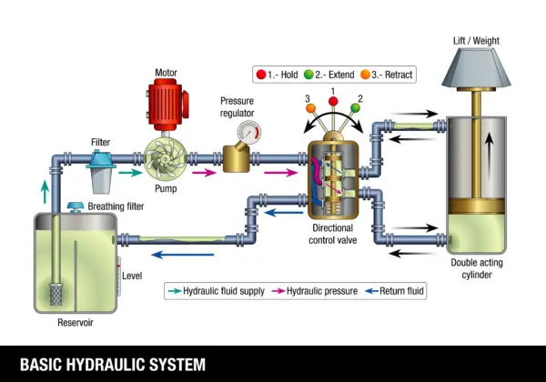
Hydraulic System
https://www.panagonsystems.com/hydraulic-pump-101-how-do-hydraulics-work/

Slide 24
Hydraulic System – Example

Slide 25
Hydraulic System - Linear actuator
The total force, F, delivered by a linear hydraulic actuator is extremely large for its size
F = pA
where A is the effective area of the piston and p is the working pressure

Slide 26
Hydraulic System - rotary cylinders
For rotary cylinders, the same principle is true except that the output is a torque
where p is the working pressure, t the rotary cylinder thickness and r1 and r2 are the inner and outer radii of the cylinder

Slide 27
Hydraulic System – Flow Rate
The flow rate Q and the volume of fluid V needed in hydraulic systems are
where dx is the desired displacement and dx/dt is the required piston velocity
By controlling the volume of the fluid entering the actuator, total displacement/rotation can be controlled
By controlling the rate at which fluid is delivered, velocity can be controlled

Slide 28
Hydraulic System – Servo-Valve
Electric actuator used to move a spool within a valve (electrohydraulic servo-valve)
The valve gives a flow rate and direction proportional to the electric current
Accurate position control in feedback control systems
Depending upon which ports are open, the direction of motion of the piston will change
Depending upon the size of the opening of the port as the spool moves, the supply flow rate is controlled, and so is the velocity of the cylinder
Depending upon the length of time the port is kept open, the total amount of fluid to the cylinder, and consequently total displacement, is controlled

Slide 29
Hydraulic System – Examples
https://www.youtube.com/watch?v=9-J2ECAKHj4
https://www.youtube.com/watch?v=VFUmGxtrS28

Slide 30
Hydraulic System
Advantages
Disadvantages
Highest power-to-weight ratio
Maintains constant torque and force
Power can be transmitted long distances
Smooth operating and movement of loads
Handles heavy loads and shock forces
No reduction gears needed
Fast motion reversal
Low overall wear because of oil lubrication
No sparks generated
Leaks easy to find
Operates in hot environments
Expensive initial installation (pump, reservoir, motor, hose...)
Noisy
Risk of contamination
High energy to operate
High maintenance
Heavy components
Large inertia on the actuator
Hydraulic fluid dangerous to human
Hydraulic fluid not environmentally friendly

Slide 31
References
Niku, S.B. , Introduction to Robotics, 2nd Edition, Wiley, New Jersey, 2011
Bolton, W. , Mechatronics, 2nd Edition, Longman, New York, 2000

